Slide 1

Essential Grammar
Sentence Completion & Vocabulary Basics
TCS Placement Practice
Dr. Nitin H. Chauhan
Humanities and Science Department
nitin.chauhan@darshan.ac.in
9016705547

Slide 2

Looping
Topics
  Noun-Pronoun Agreement
  Subject-Verb Agreement
  Tips to solve Sentence Completion

Slide 3
Noun-Pronoun Agreement

Slide 4
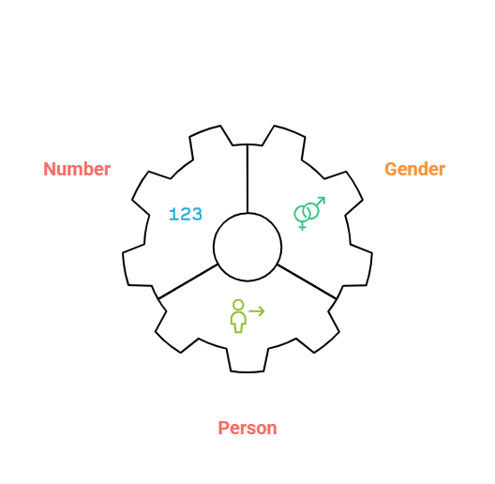
Noun-Pronoun Agreement
Noun-Pronoun Agreement refers to the grammatical agreement between the noun and the pronoun, the pronoun should match the noun it replaces:
  Gender (male, female, or thing)
    Shyam is my brother. He likes to draw.
    Meera joined the football team. She practices every evening.
    I bought a new mobile. It is very useful.
  Person (first, second, or third)
    I love reading books.
    You enjoy painting.
    He plays cricket.
  In number (singular or plural)
    The child is playing. It looks happy.
    The children are playing. They look happy.
Notes:
Image Ref: https://mentorplus.co.in/wp-content/uploads/2023/01/Parts-of-Speech-With-5-Examples-Each.jpg
https://images.app.goo.gl/3ziftbz12KYkYvmW8
https://www.shutterstock.com/search/similar/1819286891
https://www.pngwing.com/en/free-png-dhqabhttps://www.vectorstock.com/royalty-free-vector/policeman-cartoon-profession-vector-43031206

Slide 5
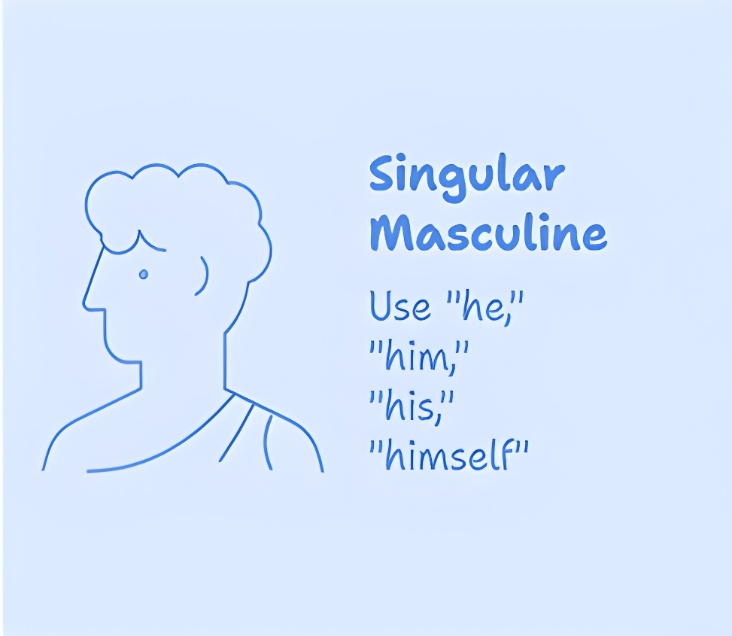
Noun-Pronoun Agreement
Rule 1: When referring to a singular masculine, use pronouns like “he,” “him,” “his,” and “himself.”
  Ravi is my friend. He is very helpful.
    masculine subject → pronoun he
  This boy is intelligent. Everyone likes him.
    masculine subject → pronoun him
  Arjun has lost his book.
    masculine subject → pronoun his
  The man solved the problem himself.
    masculine subject → pronoun himself
Notes:
Image Ref: https://mentorplus.co.in/wp-content/uploads/2023/01/Parts-of-Speech-With-5-Examples-Each.jpg
https://images.app.goo.gl/3ziftbz12KYkYvmW8
https://www.shutterstock.com/search/similar/1819286891
https://www.pngwing.com/en/free-png-dhqabhttps://www.vectorstock.com/royalty-free-vector/policeman-cartoon-profession-vector-43031206

Slide 6
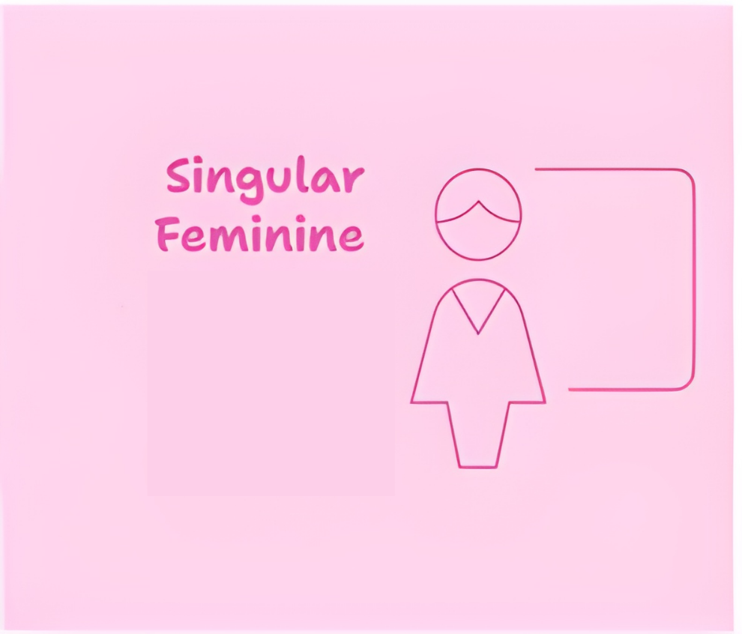




Noun-Pronoun Agreement
Rule 2: When talking about a singular feminine, use pronouns such as “she,” “her,” “hers,” and “herself.”
  Sita is a good singer. She sings beautifully.
    feminine subject → pronoun she
  This girl is my classmate. I know her.
    feminine subject → pronoun her
  Anita has forgotten her notebook.
    feminine subject → pronoun her
  The woman completed the work herself.
    feminine subject → pronoun herself
Notes:
Image Ref: https://mentorplus.co.in/wp-content/uploads/2023/01/Parts-of-Speech-With-5-Examples-Each.jpg
https://images.app.goo.gl/3ziftbz12KYkYvmW8
https://www.shutterstock.com/search/similar/1819286891
https://www.pngwing.com/en/free-png-dhqabhttps://www.vectorstock.com/royalty-free-vector/policeman-cartoon-profession-vector-43031206

Slide 7

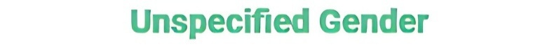



Noun-Pronoun Agreement
Rule 3: For non-living things and most animals, it is appropriate to use “it,” “its,” and “itself” as pronouns.
  The chair is broken. It needs to be repaired.
  The car is new. Its color is red.
  The computer shut down by itself.
Rule 4: If the noun refers to a person of any gender (e.g., person, pupil, scholar, reader), masculine pronouns are typically used.
  If a person works hard, he will succeed.
  Every pupil must bring his own notebook.
  The scholar presented his research at the conference.
  Each reader should bring his library card.
Notes:
Image Ref: https://mentorplus.co.in/wp-content/uploads/2023/01/Parts-of-Speech-With-5-Examples-Each.jpg
https://images.app.goo.gl/3ziftbz12KYkYvmW8
https://www.shutterstock.com/search/similar/1819286891
https://www.pngwing.com/en/free-png-dhqabhttps://www.vectorstock.com/royalty-free-vector/policeman-cartoon-profession-vector-43031206

Slide 8
Noun-Pronoun Agreement
Rule 5: The words “baby” and “child” can be used for both boys and girls, so we usually say “it” when talking about them.
  The baby is crying. I think it is hungry.
  A child was lost in the mall. Luckily, it was found by the security guard.
Rule 6: When the noun is plural and can be male or female, or is a non-living thing, we use they, them, their, theirs, themselves.
  The girls are singing. They sound great.
  The chairs are broken. We need to fix them.
  The students brought their books.
  The bags are new. Theirs are blue and white.
  The teachers introduced themselves before starting.
Notes:
Image Ref: https://mentorplus.co.in/wp-content/uploads/2023/01/Parts-of-Speech-With-5-Examples-Each.jpg
https://images.app.goo.gl/3ziftbz12KYkYvmW8
https://www.shutterstock.com/search/similar/1819286891
https://www.pngwing.com/en/free-png-dhqabhttps://www.vectorstock.com/royalty-free-vector/policeman-cartoon-profession-vector-43031206

Slide 9


Noun-Pronoun Agreement
Rule 7: We usually use “it” to talk about animals, even if the word for the animal suggests a specific gender, like “cow” or “bull.”
  A bull ran across the road. It looked very strong.
  The cow is in the field. It is eating grass.
  A lion is resting under the tree. It looks tired.
  A parrot is sitting in the cage. It is making a lot of noise.
  The elephant is crossing the river. It is very big.
  A monkey is climbing the tree. It is very quick.
Notes:
Image Ref: https://mentorplus.co.in/wp-content/uploads/2023/01/Parts-of-Speech-With-5-Examples-Each.jpg
https://images.app.goo.gl/3ziftbz12KYkYvmW8
https://www.shutterstock.com/search/similar/1819286891
https://www.pngwing.com/en/free-png-dhqabhttps://www.vectorstock.com/royalty-free-vector/policeman-cartoon-profession-vector-43031206

Slide 10
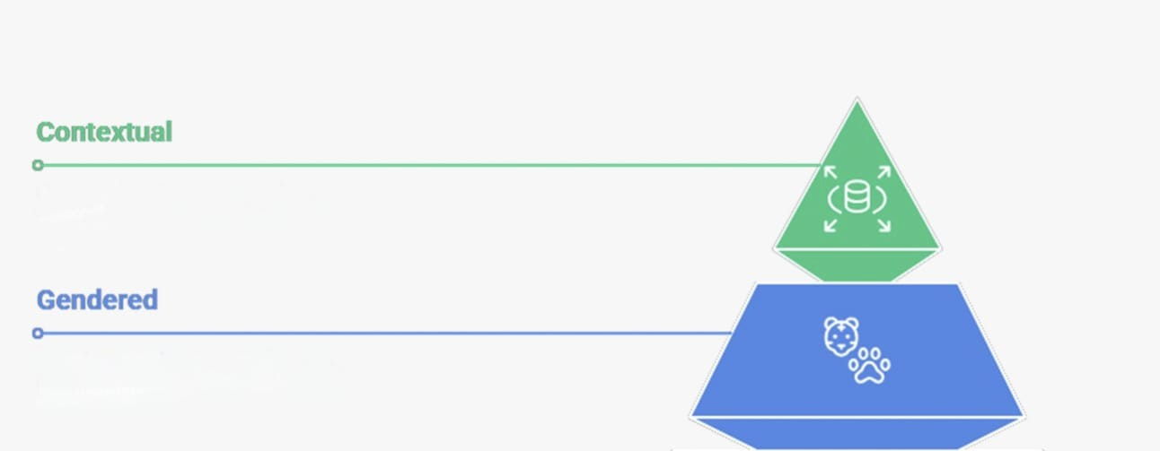
Noun-Pronoun Agreement
Rule 8: We use "he" or "she" for animals when the context or situation makes their gender important. (Pet animals, which are often considered as members of the family, are usually referred to using pronouns appropriate to their gender.)
  We usually call our pet dog Rocky a part of the family. He loves playing in the garden and waits by the door when it’s time for a walk. Our neighbor has a cat named Misty. She is very friendly and often visits our house.
Notes:
Image Ref: https://mentorplus.co.in/wp-content/uploads/2023/01/Parts-of-Speech-With-5-Examples-Each.jpg
https://images.app.goo.gl/3ziftbz12KYkYvmW8
https://www.shutterstock.com/search/similar/1819286891
https://www.pngwing.com/en/free-png-dhqabhttps://www.vectorstock.com/royalty-free-vector/policeman-cartoon-profession-vector-43031206

Slide 11



Noun-Pronoun Agreement
Rule 9: Words begin with every-(everyone, everybody, everything) are singular, and must therefore be referred to by the singular pronouns.
  Everyone must check his answers twice.
  Everybody shared his opinion.
  Everything in the box has its label.
Everybody
Everyone
Everything
Notes:
Image Ref: https://mentorplus.co.in/wp-content/uploads/2023/01/Parts-of-Speech-With-5-Examples-Each.jpg
https://images.app.goo.gl/3ziftbz12KYkYvmW8
https://www.shutterstock.com/search/similar/1819286891
https://www.pngwing.com/en/free-png-dhqabhttps://www.vectorstock.com/royalty-free-vector/policeman-cartoon-profession-vector-43031206

Slide 12
Subject-Verb Agreement
Notes:
Gif Reference: https://tenor.com/view/tkthpsharma-gif-23317246

Slide 13

Subject-Verb Agreement
Look at the following sentences and find whether they are correct or not.
  Prabha and Seema is here.
  Kavish, Raj and Reena goes to the same school.
  She and her friend has arrived.
  He and I was playing in the garden.
The above given sentences are wrong because the subject in each of sentences being plural need to have the plural verb.
  Prabha and Seema are here.
  Kavish, Raj and Reena go to the same school.
  She and her friend have arrived.
  He and I were playing in the garden.
A verb must agree with its subject in number and person.
Use Plural Verb?
Use Singular Verb?

Slide 14
Subject-Verb Agreement
Rule 1 : Singular subject takes singular verb.
  My brother plays football well.
  Rina works at a bank.
  A bird sings in the morning.
Rule 2: Singular subjects joined by certain connectors takes singular verb. i.e. as well as, along with, together with, accompanied by.
  Ravi, as well as his brother, plays the guitar.
  The cat, along with its kitten, is hiding under the bed.
  The manager, together with his team, is working on the project.
  The principal, accompanied by his staff, visits the classrooms.

Slide 15
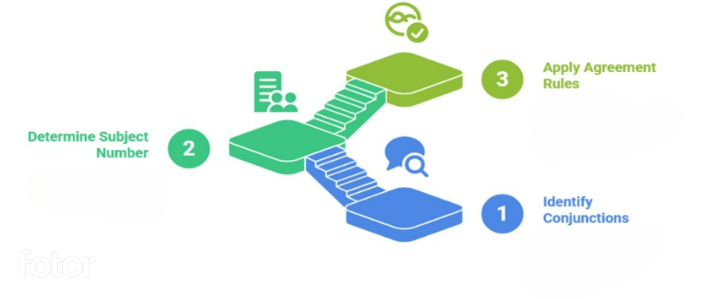
Subject-Verb Agreement
Rule 3 : Singular subjects joined by, ‘either...or’, ‘neither...nor’ take a singular verb. Plural subject joined by these connectors take plural verb.
  Either Asha or Anjali is bringing the cake for the party.
  (Both subjects are singular, so we use the singular verb “is.”)
  Neither the boys nor the girls were interested in the activity.
  (Plural subjects take the plural verb “were.”)

Slide 16
Subject-Verb Agreement
Rule 4: When singular and plural subjects are joined by, ‘either…or’, ‘neither…nor’ the verb agrees with the nearest subject. If the nearest subject is plural, the verb will be plural. If the nearest subject is singular, the verb will be singular.
  Either the teacher or the students are going to arrange the program.
    nearest subject = students → plural → are
  Either the students or the teacher is responsible for this mistake.
    nearest subject = teacher → singular → is
  Neither the manager nor the workers are willing to accept the proposal.
    nearest subject = workers → plural → are
  Either Manjit or his brothers have broken the window glass.
    nearest subject = brothers → plural → have
  Neither the tractors nor the trailer was sold.
    nearest subject = trailer → singular → was

Slide 17
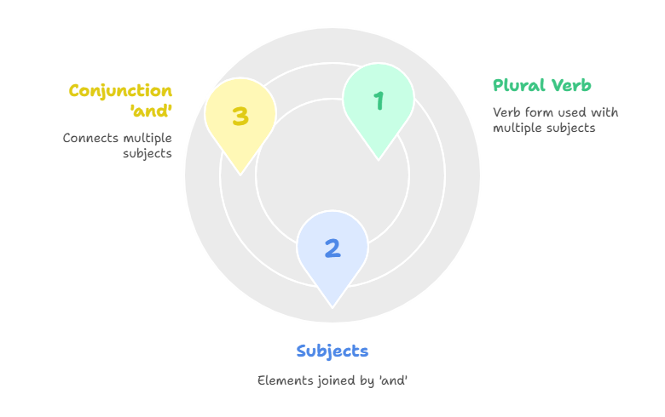
Subject-Verb Agreement
Rule 5: Subjects joined by ‘and’ take a plural verb.
  Ram and Shyam are good friends.
    two subjects joined by and → plural verb are
  The teacher and the students were present in the meeting.
    teacher + students → plural verb were
  Honesty and hard work bring success.
    two qualities joined by and → plural verb bring
  My brother and I are going to the market.
    brother + I → plural verb are
  The singer and the musician have arrived for the program.
    Two persons → plural verb have

Slide 18
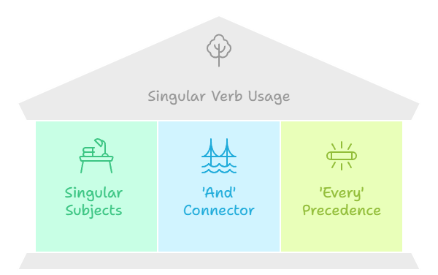
Subject-Verb Agreement
Rule 6: Singular subjects joined by ‘and’ and preceded by ‘every’ take a singular verb.
  Every boy and every girl is invited to the function.
    each subject is considered separately → singular verb is
  Every teacher and every student has to attend the seminar.
    treated as individual responsibility → singular verb has
  Every pen and every notebook belongs to the library.
    singular ownership → singular verb belongs
  Every table and every chair was arranged neatly in the hall.
    Focus is on each single object one by one → singular verb was
  Every parent and every guardian cares for the child.
    Treated as individual responsibility → singular verb cares

Slide 19
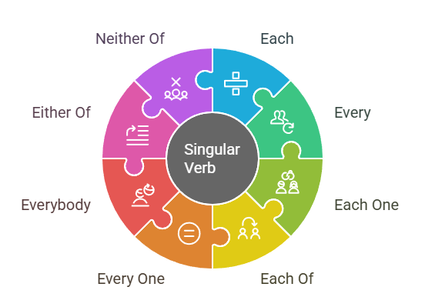
Subject-Verb Agreement
Rule 7: ‘Each’, ‘every’, ‘each one’, ‘each of’, ‘every one’, ‘everybody’, ‘either of’, ‘neither of’ take a singular verb.
  Each student is responsible for their own work.
  Every bird is sitting on a different branch.
  Each one of the flowers is blooming beautifully.
  Each of the answers is correct.
  Every one of the letters has been delivered.
  Everybody enjoys the annual college festival.
  Either of the options is fine with me.
  Neither of the boys is ready for the match.

Slide 20
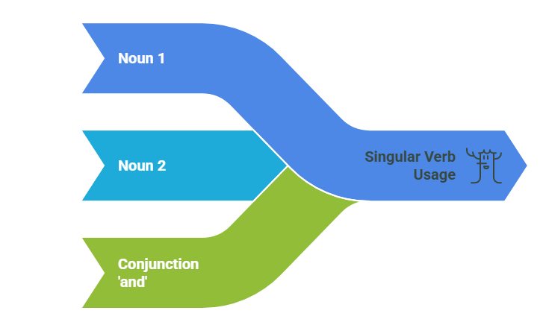
Subject-Verb Agreement
Rule 8: If the two nouns are joined by ‘and’ refer to the same person or thing the verb is singular not plural.
  Our doctor and family friend is visiting us today.
  The principal and headmaster is addressing the students.
  The poet and philosopher is speaking at the event.
  The owner and manager of this shop is very polite.
  The singer and dancer is performing tonight.
  The chairman and director of the company is arriving soon.
  Our neighbor and friend is moving to Delhi.
  My teacher and guide has encouraged me a lot.

Slide 21
Subject-Verb Agreement
Rule 9: Introductory ‘there’ in the beginning of a sentence can have singular or plural verb form. It depends on the subject which follow the verb.
  There is a pen on the table.
  There are two books on the table.
  There is a student waiting outside.
  There are many students in the library.
  There is a problem with this computer.
  There are several errors in your answer sheet.
  There is a bird sitting on the branch.
  There are birds flying in the sky.

Slide 22
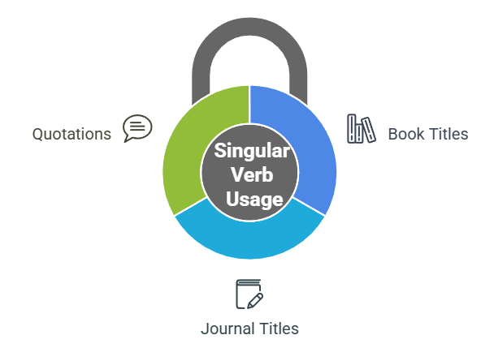
Subject-Verb Agreement
Rule 10: When the subject is title of a book or a journal, a quotation expressing a single idea, the verb is singular.
  “Friends” is my favorite TV show.
  “Statistics for Beginners” is a helpful book.
  “Time is money” is something my teacher always says.
  “The World of Science” is a useful journal for students.
  “Unity is strength” is an old saying.
  “Honesty is the best policy” is what my parents taught me.
  “The Hindustan Times” is widely read across India.
  “The Bhagavad Gita” is a sacred text of Hinduism.
  “Knowledge is power” is a truth we cannot deny.

Slide 23
Subject-Verb Agreement
Rule 11: Some nouns are always used in the plural form because they naturally refer to objects made of two parts, groups, or abstract ideas. Since they are plural in form and meaning, they always take a plural verb.
  Scissors are on the table.
  Trousers are dirty.
  Spectacles are missing.
  Shoes are lying at the door.
  Jeans are popular among youngsters.
  Shorts are in the cupboard.
  Socks are hanging on the rope.
  Binoculars are useful for bird watching.
  Slippers are under the bed.
  Goggles are fashionable these days.

Slide 24
Subject-Verb Agreement
Rule 12: When fractions or percentages are used with of, the verb depends on the noun that follows.
  Fifty percent of the work is done.
    work (uncountable) → singular verb is
  Fifty percent of the people are absent.
    people (countable plural) → plural verb are
  One-third of the cake is missing.
    cake (singular) → singular verb is
  One-third of the students were late.
    students (plural) → plural verb were
  Some of the water is wasted.
    water (uncountable) → singular verb is
  Some of the books are old.
    books (plural) → plural verb are

Slide 25
Tips to solve Sentence Completion
Notes:
Gif Reference: https://tenor.com/view/tkthpsharma-gif-23317246

Slide 26
Tips to solve Sentence Completion
Decoding Structure: Mastering Single and Double Blank logic.
Signpost Secrets: Using "Direction" to predict missing words.
Vocabulary Alchemy: The "Charge & Tone" strategy for elimination.
Trap Avoidance: Sidestepping common examiner tricks.

Slide 27
Core Sentence Types
Single-Blank Format
  Focus on a single missing element. The clue is always hidden within the sentence context.
Double- Blank Format
  The "Elimination Engine". Use the easier blank first to clear 50-75% of options instantly.

Slide 28
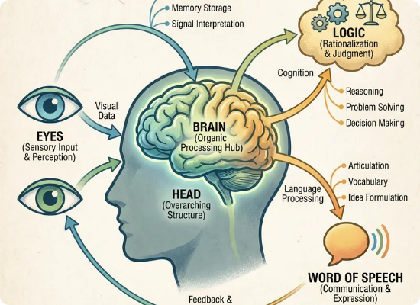
The Secret Weapon: Signposts
Signpost words act like traffic signals.
They tell you which direction the sentence is moving before you even read the options.
Never read a sentence; decode it.

Slide 29
The Directional Categories
Contrast (U-Turn)
  Words like Although, But, Yet, Despite. Part A ≠ Part B.
Cause/Effect
  Words like Because, Thus, Resulting. Part A → Part B.
Similarity
  Words like Just as, Similarly, Likewise. Part A = Part B.

Slide 30
The Fail-Proof 3-Step Method
Identify the Signpost
  Locate the traffic signal word (e.g., Although, Because, However) that defines the logical relationship between the clauses (Contrast vs. Continuation).
Determine the 'Charge’
  Predict whether the missing word needs to be Positive (+), Negative (-), or Neutral (0) based on the context clues surrounding the blank.
Filter & Eliminate
  Cross-examine the answer choices against your predicted charge. Eliminate options that have the wrong tone or break the sentence's logical direction before making your final selection.

Slide 31
Examiner Traps to Avoid
The "Sounds Good" Trap: Picking a fancy word that breaks the logic.
Partial Match: First word fits, second word fails (Double Blanks).
The Obscure Mirage: Choosing a word just because you don't know it.

Slide 32
Thank You

